Slide 1
BIAS
Fundamentals of Law Practice
Georgia State University College of Law
Tiffany Roberts, Esq.

Slide 2
Before presentation:
Complete RACE IAT
Complete OTHER IAT
Browse glossary of social justice terms & discuss

Slide 3
What is bias?
Prejudice; an inclination or preference, especially one that interferes with impartial judgment.
https://studentleadership.northseattle.edu/sites/studentleadership.northseattle.edu/files/D2-Diversity-and-Social-Justice-Terminology.pdf

Slide 4
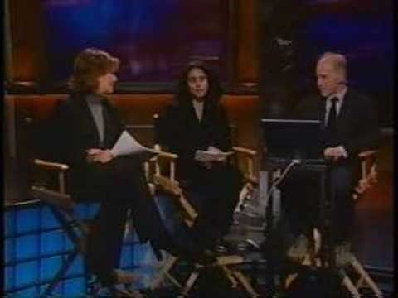
IMPLICIT ASSOCIATION TEST

Slide 5
Are we required to be impartial as lawyers?
Y/N

Slide 6
Can bias affect our roles as zealous advocates?

Slide 7
RULE 1.7 CONFLICT OF INTEREST: GENERAL RULE
A lawyer shall not represent or continue to represent a client if there is a significant risk that the lawyer's own interests or the lawyer's duties to another client, a former client, or a third person will materially and adversely affect the representation of the client, except as permitted in (b).
If client informed consent is permissible a lawyer may represent a client notwithstanding a significant risk of material and adverse effect if each affected client or former client gives informed consent, confirmed in writing, to the representation after:
consultation with the lawyer, pursuant to Rule 1.0(c);
having received in writing reasonable and adequate information about the material risks of and reasonable available alternatives to the representation, and
having been given the opportunity to consult with independent counsel.
Client informed consent is not permissible if the representation:
is prohibited by law or these Rules;
includes the assertion of a claim by one client against another client represented by the lawyer in the same or substantially related proceeding; or
involves circumstances rendering it reasonably unlikely that the lawyer will be able to provide adequate representation to one or more of the affected clients.
Though otherwise subject to the provisions of this Rule, a part-time prosecutor who engages in the private practice of law may represent a private client adverse to the state or other political subdivision that the lawyer represents as a part-time prosecutor, except with regard to matters for which the part-time prosecutor had or has prosecutorial authority or responsibility.
The maximum penalty for a violation of this Rule is disbarment.

Slide 9
Judges

Slide 10
MAN
ASIAN
She is ghetto.
LATINX
GAY
He has a criminal history.
BLACK
They are too rich to care.
TRANS
They are poor.
She looks guilty.
WHITE
They are uneducated. I can’t explain everything.
She is too young to understand.
WOMAN
He looks violent.
UNDOCUMENTED

Slide 11
BAD NEIGHBORHOOD
FEELS THREATENING
LOOKS SCARY
X TYPE OF GUY
BAD PART OF TOWN
NOT THE BEST [NOUN]
HIGH DRUG AREA

Slide 12
WHAT MAKES IT AN –ISM?

Slide 13
HOW DO WE REINFORCE –ISMS IN PRACTICE?

Slide 14
How do we regulate ourselves?

Slide 15
WHAT IF THERE IS NO RULE?

Slide 16
